Slide 1
UML Study Buddy App
Hussain Dar and Sridhar Rangan

Slide 2
Goal
UML Study Buddy App is designed to help students get to know other students in specific classes
This is so that these students can meet up to work together on homework, study for quizzes and exams, and do group projects together.
The app will be available for all students and will help introverted students and those who need help in their classes find additional help with peers.

Slide 3
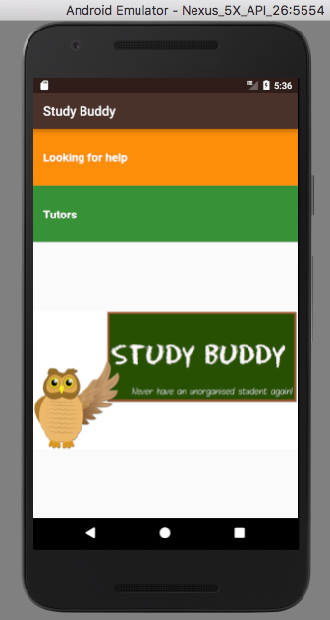
Added classes
Here is a basic UI for searching for classes you would like help in
Provides tutoring schedules for classes that students need help in

Slide 4
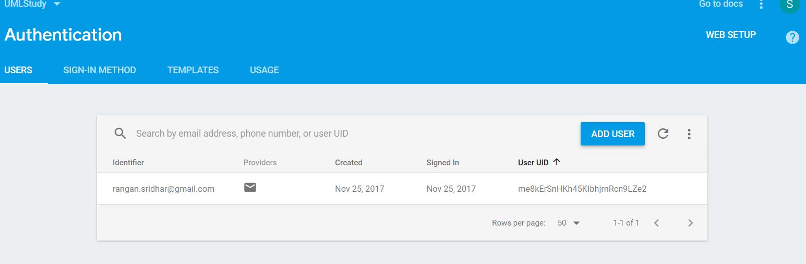
Added User into Database

Slide 5
What has each person done
Sridhar Rangan – Worked on Firebase and the implementation of accounts. Now have a working database with the ability to add accounts through emails as well as log in if an email has been registered.
Hussain Dar – Working on creating an list of classes for students to choose from and customizing the UI.
Both – Will need to work on merging the database/accounts to the be able to view the list of classes.

Slide 6
Challenges
Ran into some difficulty merging the firebase database with the classes
We should be able to now merge both components and have a complete app by the presentation

